Slide 1
EXCEL CAPSTONE PROJECT
BY ASHISH HALIJOL

Slide 2
ABOUT THE PROJECT :
THE PROJECT IS ALL ABOUT THE DESCRIPTIVE ANALYSIS OF ELECTRONIC SUPERSTORE TAKEN FROM Kaggle.com. WHICH CONTAINS 731 ROWS AND 13 COLUMNS.
THE COLUMNS CONSISTS OF MANY PARAMETERS SUCH AS ORDER ID, ORDER PRIORITY, ORDER QUANTITY,SALES,SHIP MODE,PROFIT,ETC
THIS STUDY HELP YOU TO UNDERSTAND THE PRESENT BUSINESS SCENARIOS WHICH HELPS TO MAKE THE STRATEGIES FOR THE GROWTH OF THE BUSINESS IN THE NEAR FUTURE.

Slide 3
PROBLEM STATEMENTS :
WHICH PRODUCT CATEGORY HAS HIGHEST PROFIT?
WHICH CONSUMER SEGMENT HAS HIGHEST PROFIT?
WHICH REGION HAS HIGHEST PROFIT?
WHICH CUSTOMER SEGMENT HAS MOST ORDER QUANTITY?
WHICH CATEGORY HAS MOST NO. OF SALES?
WHICH REGION HAS MOST NO. OF SALES?
PERFORM CONDITIONAL FORMATTING FOR ORDER PRIORITY,PROFIT,SHIP MODE,PRODUCT CATEGORY
WHICH CATEGORY HAS MOST NO OF SALES,ORDER QUANTITY AND PROFIT USING SPARKLINES?
USER SHOULD GET EVERY DETAIL OF ORDER BY JUST ENTERING INPUT AS ORDER ID ,USE VLOOKUP?

Slide 4
HIGHEST PROFIT OF PRODUCT CATEGORIES
TECHNOLOGY CATEGORY HAS HIGHEST PROFIT

Slide 5
HIGHEST PROFIT OF A CONSUMER SEGMENT
CORPORATE SEGMENT HAS HIGHEST PROFIT

Slide 6
HIGHEST PROFIT OF A REGION
NORTHWEST TERRITORIES REGION HAS HIGHEST PROFIT

Slide 7
MOST ORDER QUANTITY OF CONSUMER SEGMENT
CORPORATE SEGMENT HAS MOST ORDER QUANTITY

Slide 8
MOST SALES OF A PRODUCT CATEGORY
TECHNOLOGY CATEGORY HAS MOST SALES

Slide 9
MOST SALES OF A REGION
WEST REGION HAS MOST SALES

Slide 10
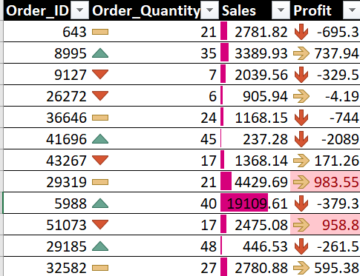
ANALYZE ORDER ID,QUANTITY SALES AND PROFIT USING CONDITIONAL FORMATTING

Slide 11
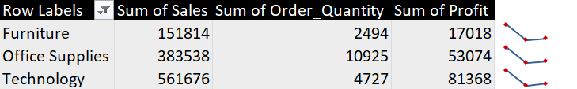
Analyze sales, order quantity and profit for product categories using sparklines

Slide 12
VLOOKUP
FOR EXAMPLE I HAVE ENTERED ORDER ID 1059 AND I GET EVERY DETAIL OF THE PRODUCT PRESENT IN THE DATASET.
EVERY TIME USER CHANGES ORDER ID DETAILS CHANGE.
FORMULA OF VLOOKUP : =IFERROR(VLOOKUP($A$3,abc,COLUMNS($A$2:B2),FALSE),"")

Slide 13
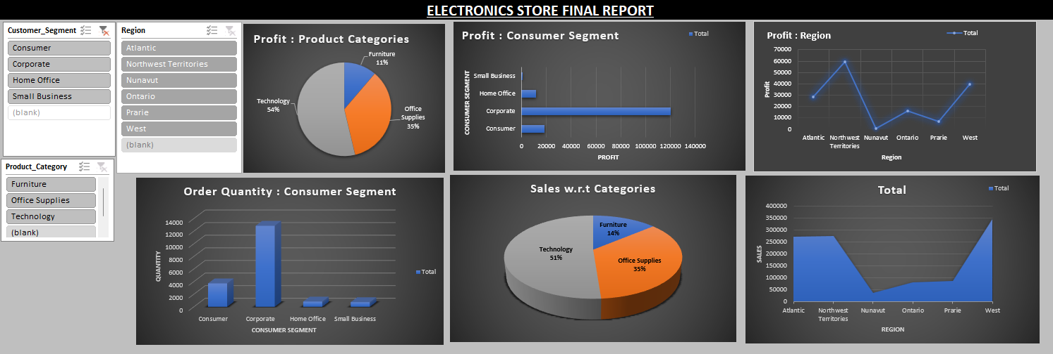
DASHBOARD

Slide 14
CONCLUSION
FROM THE STUDY IT IS CLEAR TO UNDERSTAND THAT THE STORE HAS PICKED UP A GOOD RISE BUT THEY NEED TO KEEP GROWING ORDERS BY SALES PROMOTION STRATEGIES.
DISCOUNT SCHEME SHOULD BE IMPLEMENTED IN REGIONS WITH LOWER SALES TO BOOST BOTH SALES AND PROFITS.
CORPORATE SEGMENT HAS MOST ORDERS AND PROFITS,CONSUMER SEGMENT HAS AVERAGE SALES AND PROFITS.HENCE ORDER DELIVERY, TIME TO TIME SERVICES SHOULD BE PLANNED ACCORDINGLY.
THE CUSTOMERS MOSTY PREFERRED REGULAR MODE OF SHIPMENT THIS IS A GOOD SIGN FOR THE BUSINESS BUT WE MUST TRY TO SHIFT THOSE CUSTOMERS TO SAME DAY SHIPPING TYPE BY PLANNING SOME OFFERS,STORE VOUCHERS,MEMBERSHIPS,ETC USING EXPRESS AIR MODE.

